Slide 1
The Florida Standards Assessment: What Every Parent Should Know!
Manatee Elementary
Parent Info Night
2022

Slide 2
Questions to Answer:
What is the FSA (Florida Standards Assessment)?
When will students take the FSA?
How will we help your child at school?
How can you help your child at home?
Where can you find additional resources to help prepare your child?

Slide 3
What is the FSA?
The Florida Standards Assessments (FSA) will measure student mastery of the Florida Standards through a variety of item types.
All Florida schools teach the Florida Standards.
In Grade 3, students are tested in Reading and Math. *Promotional Requirement = Reading*
In Grade 4 & 5, students are tested Reading, Writing and Math
In Grade 5 only, students are tested in Science
The tests are paper and pencil format
Tests are approximately 80 minutes each test session

Slide 4
3rd grade Promotional Requirement: It’s the Law!
Students who score at Level 1 in reading
on the FSA will be retained.
However, if the student demonstrates the required reading level through an alternate way, (Stanford-10 Assessment, iReady Diagnostic), they can be granted good cause promotion to 4th grade.
Students who do not demonstrate mastery will be invited to summer school, where they will be provided with another opportunity to demonstrate their knowledge of 3rd grade standards.

Slide 5
When will students take the FSA?
April 4th- Writing: 4th and 5th grade
April 5th & 6th- ELA: 3rd grade
May 3rd and 4th - ELA : 4th and 5th grade
May 10th and 11th – Math: 4th and 5th grade
May 17th and 18th – Science: 5th grade
Make-up tests must be given when students are absent.

Slide 6
Ready on Test Day!
Encourage your child to eat breakfast before all testing days!
Please have your child get plenty of rest the night before! Go to bed at an earlier time.
Please have your child attend school on all test days!

Slide 7
Florida Standards Assessment
Reading and Math Examples

Slide 8
Types of Questions on ELA FSA
Multiple Choice
Multi-Select
Table Response
Two-Part Items
Editing Tasks

Slide 9
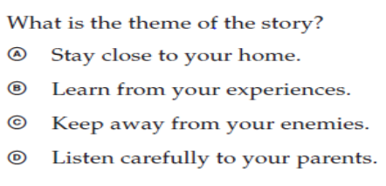
Multiple Choice Items
For these items, the students must choose the best answer from the answer choices and fill in one bubble for the correct answer.

Slide 10
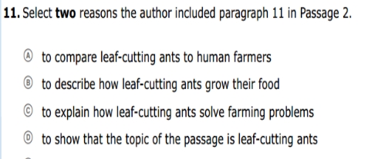
Multi-Select Items
The student is directed to select all (or a specific number) of the correct answers from among a number of options
These items are different from multiple-choice items, which allow the student to select only one correct answer.

Slide 11
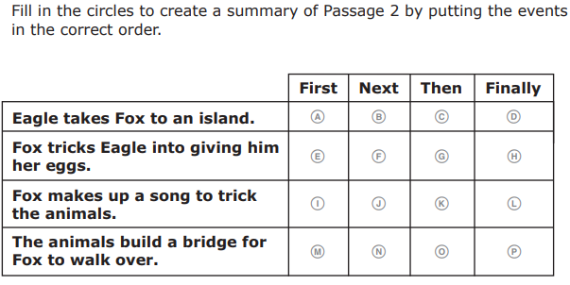
Table Response
Students will complete a table by bubbling an answer for each sentence.

Slide 12
Two-Part Items
In this two-part item, the student is directed to select the correct answers from Part A and Part B.
Part A is multiple-choice
Part B may be either multiple-choice or multi-select
Part A often asks the student to make an analysis or an inference, and Part B requires the student to use the text to support the answer they chose from Part A
Example on the next slide

Slide 13
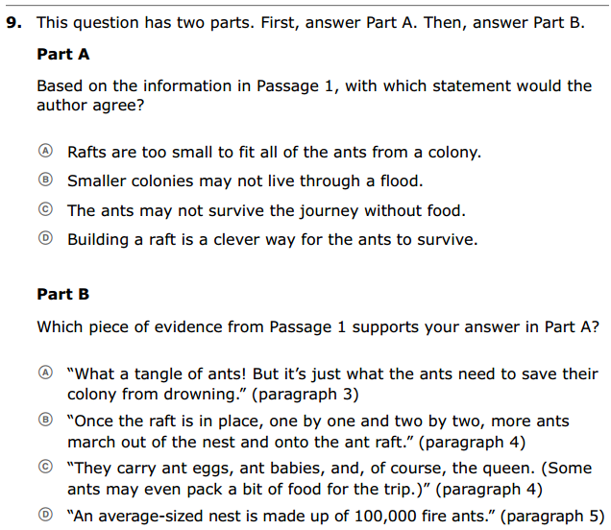
Two-Part Items

Slide 14
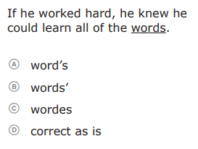
Editing Task
For editing items, students must choose the correct word or phrase to fill in the blank in the passage

Slide 15
Types of Questions on the
Math FSA
Multiple Choice
Multi-Select
Response Grids
Table Items

Slide 16
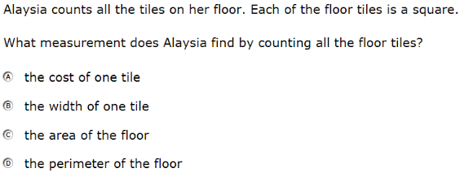
Multiple Choice Items
For these items, students must choose the best answer from the answer choices and fill in one bubble for the correct answer.

Slide 17
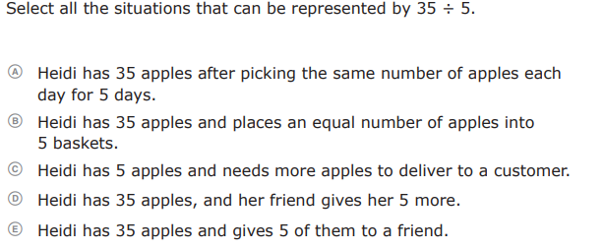
Multi-Select Items
The student is directed to select all (or a specific number) of the correct answers from among a number of options.

Slide 18
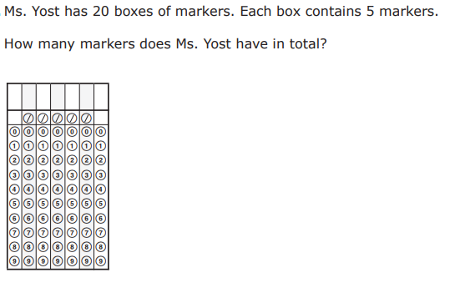
Response Grids
The student will answer questions by filling in a grid.

Slide 19
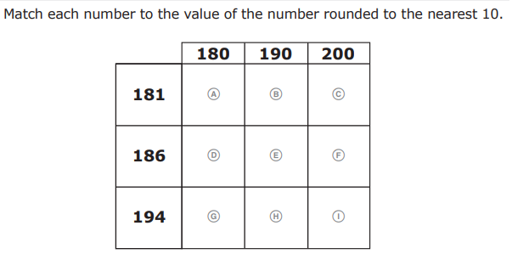
Table Items
The student will answer questions by filling in a table.

Slide 20
How are WE helping your child at school?
Standards-based reading instruction
Specific interventions to meet individual student needs
Ready Reading/Math Booklets that mirror FSA test questions.
iReady Learning Paths
Mock FSA Practice Tests

Slide 21
How can YOU help at home?
Read with your child every day!
Go over homework with your child.
Stay involved in your child’s education.
Offer positive support and feedback to your child. ☺
Encourage your child to relax and do his or her very best every day.

Slide 22
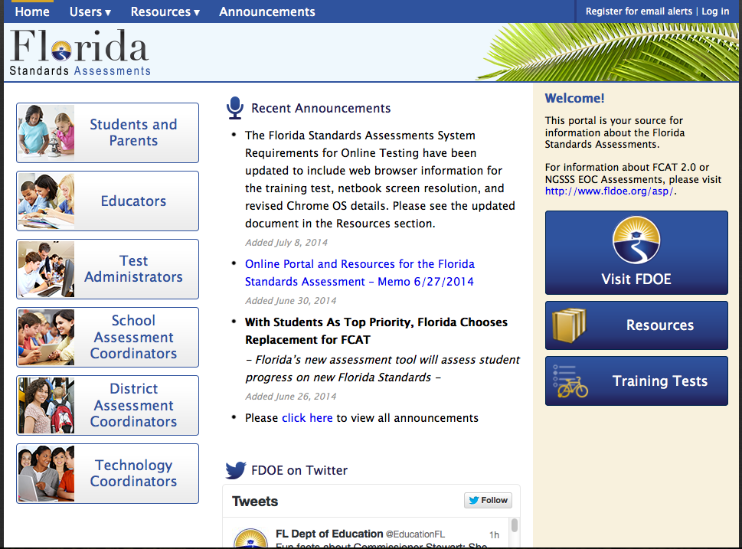
Parent Informational Resource
FSA Portal
http://www.fassessments.org/

Slide 23
Questions?
Please call or email your child’s teacher with any questions or concerns.

